Slide 1

Sindh Engro Coal Mining Company Thar Block II Open Pit Lignite Mine Power Sourcing Economic Modeling
V4.0 | 02-05-24

Slide 2
Baseline Site, Load and Energy Data

Slide 3

Load Projection
The above load projection as well as hourly load data was combined to form hourly load projections over 12 years.

Slide 4
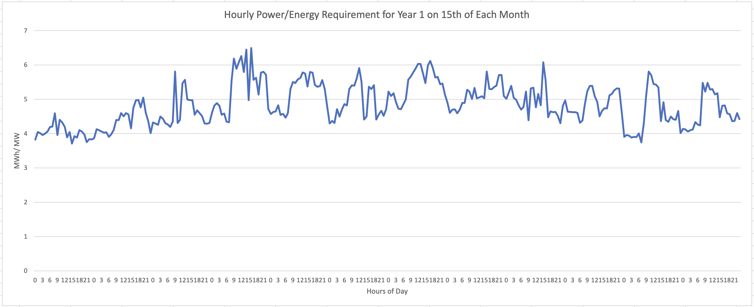
Hourly Energy Demand Projection
The first task of the model is to select sources that can meet the hourly energy demand.

Slide 5
Energy Demand

Slide 6
Key Assumptions

Slide 7
Assumptions
Exchange Rate: 1 USD = 290
Loss amount: PKR 24,000,000 per hour of critical load interruption
Loss duration: any load interruptions due to power failures are considered to be only one hour long. This is because most load interruptions will be caused by lack of stability and inadequate spinning reserve in the system
Existing generator sets capital cost: PKR 45,000,000 per MW.
Diesel Generator depreciation is not included in the financials.
Source probable failures and downtimes are defined as per experience for each source type (see Source Details)

Slide 8
Assumptions
BESS units provide instantaneous backup to any kind of power deficit due to inadequate capacity of sources or sudden reduction of capacity.
BESS units also provide long term power in case of power deficit.
Load shedding of non-critical load does not result in any financial loss.

Slide 9
Inflation Assumptions
Model incorporates different inflation levels for each source.
Solar and BESS sources have 5% inflation rate reflecting decreasing $/W cost due to technology improvements.
Steam Turbine source also has 5% inflation rate, as fuel is locally available at a subsidized cost.
Furnace oil and diesel fueled generator sources have a higher 7.5% inflation due to import dependence.
All financial numbers are in USD.
Inflation is not considered.

Slide 10
Details of Power Sources

Slide 11
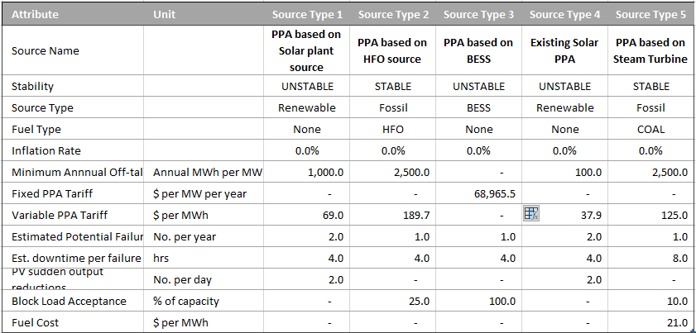
Source Details (PPA Sources)

Slide 12
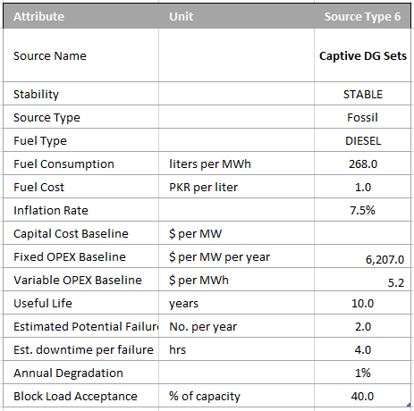
Source Details (Captive Source)

Slide 13
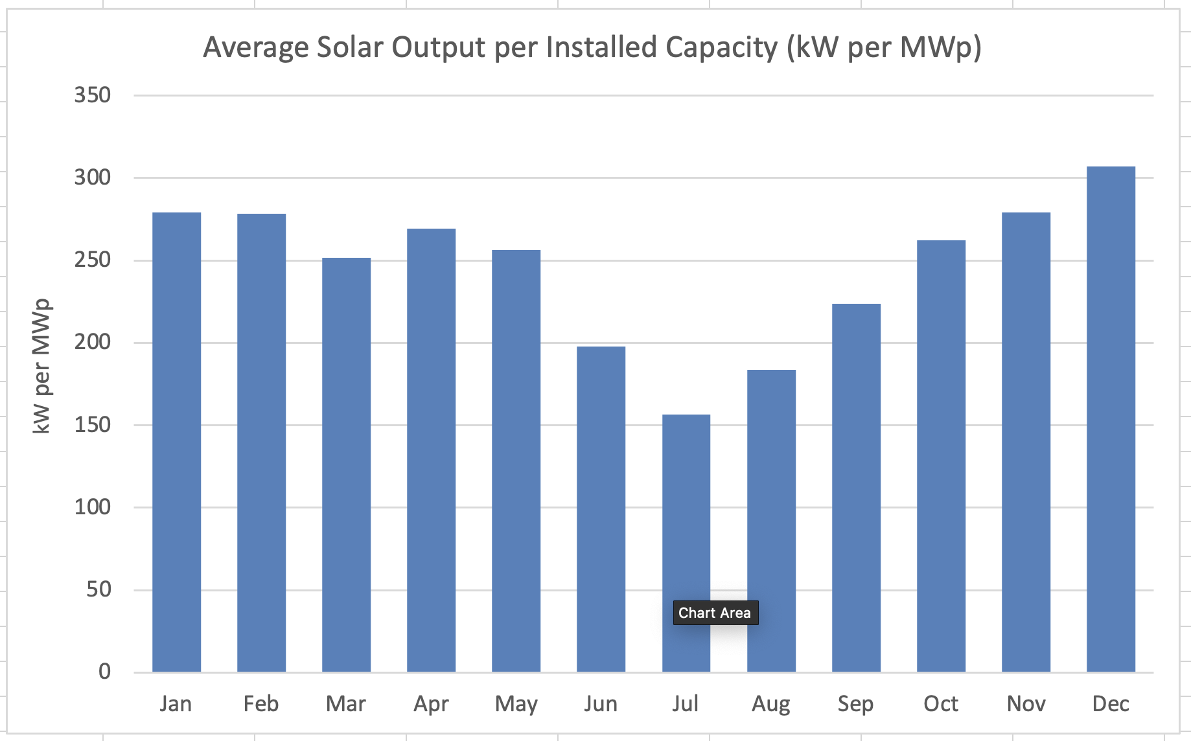
PV Generation Trend

Slide 14
Modeling Algorithm, Evaluation and Results

Slide 15
Model Algorithm/ Approach
Consider hourly power demand
Meet Remaining demand with least number of highest priority sources
Utilize Reserves and BESS, if needed to meet demand, otherwise preserve
Simulate probabilistic source failures
Check if operational sources/ BESS can meet sudden deficit within 4 seconds
If required, shed non-critical load,
Repeat for each hour in day, in month, in years (12)
Aggregate technical and commercial data
Input Load, Solar Profile and Source Configuration
Calculate Evaluation Metrics
Start
End
Operate Stable sources at min load req. for Spinning Reserve
Record data operating hourly data

Slide 16
Scenario Evaluation Metrics
1. Energy Fulfilment Ratio (%):
Calculated for each year and as a single metric
Number of hours in which power sources meet energy requirements without load shedding / total number of hours
Must be 99-100% for scenario to be viable
2. Critical Load Interruptions (No.):
Calculated for each year and as a single metric
Number of times critical load is interrupted due to source failures (and inadequate spinning reserve) despite non-critical load shedding
3. Load Shedding Events(No.):
Non-critical loads are shed if sources cannot meet critical load requirements. While this is not modeled to result in financial loss, it is a sustainability consideration

Slide 17


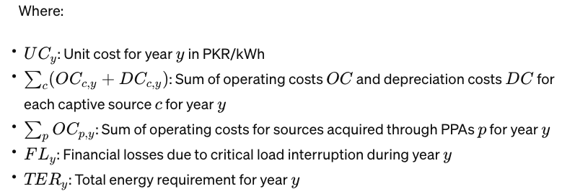
Scenario Evaluation Metrics (continued)
4. Average Unit Cost (AUC) in PKR/ kWh:

Slide 18
Modeling Outcomes
No. | Scenario Description | Critical Load Interruptions | Non Critical Load Shed Events | Avg Cost ($/kWh) | Notes
1 | Existing PV Plant – 5 MW New PV Plant – 40 MW (Year 1) New PV Plant – 5 MW (Year 3) New PV Plant – 5 MW (Year 5) New PV Plant – 5 MW (Year 8) ------ 60MWh BESS (Year 1) 5MWh (Year 3) 10MWh (Year 5) 10MWh (Year 8) 10MWh ( Year 10) ------ 6 x 1.5MW HSD from Year 1 | 0-1 | 52 | 0.20 | Staged addition of PPA sources keeps the average unit low.

Slide 19
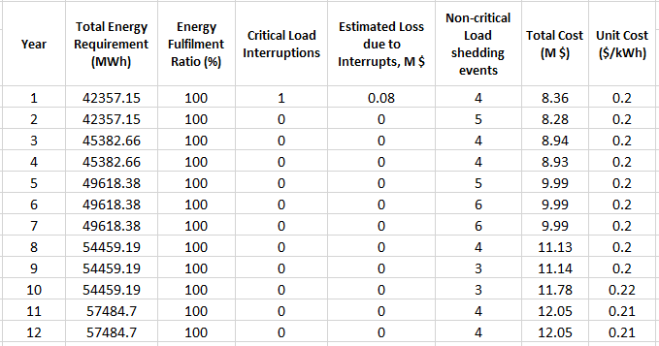
Scenario 1: Summary

Slide 20
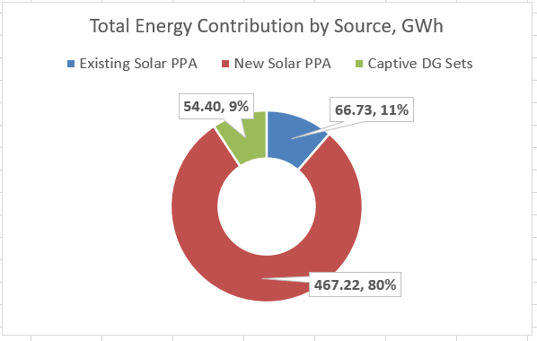
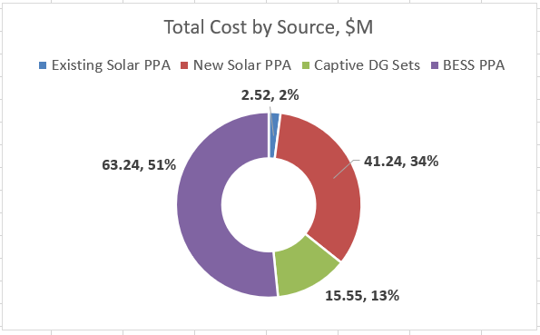
Scenario 1: Summary

Slide 21
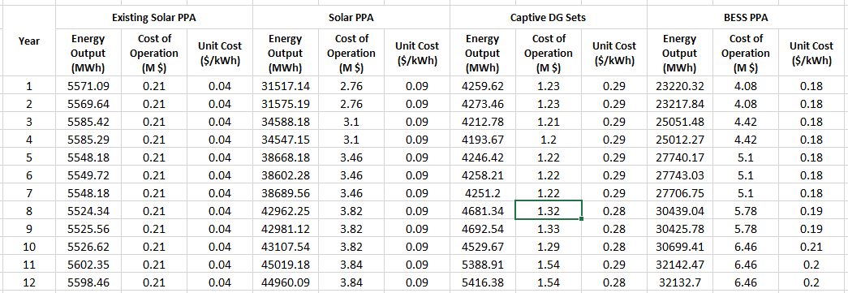
Scenario 1: Year-wise Source breakdown

Slide 22
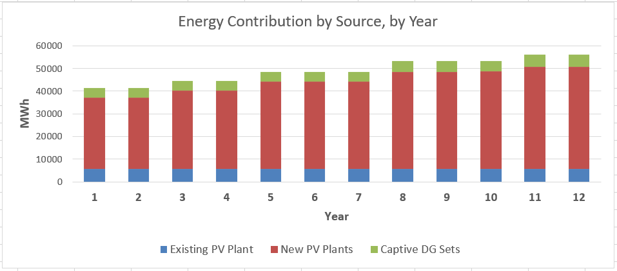
Scenario 1: Year-wise Source breakdown

Slide 23
Discussion
Scenario 1 has been created using large installation of PV and BESS as primary sources with DG strictly providing backup.
Adding all BESS and PV capacity in Year 1 is disadvantageous and the full capacities cannot be utilized because of lower demands in the early years.
PV and BESS capacity is added as load is increased.
Based on Solar profile received from SECMC, there are multiple times during the year in which solar output is very low. These days are scattered throughout the year (cloudy weather) but occur with severity in July/ August. Because of these, solar cannot adequately charge BESS during the day, due to which diesel is run to charge batteries

Slide 24

Thank you!

